Slide 1

Neurograph

Slide 2
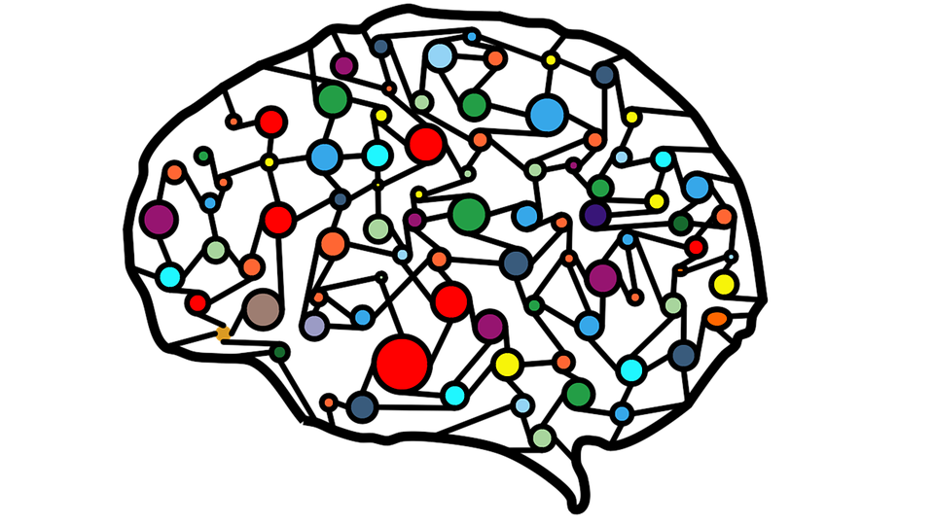
The human brain is a complex network whose operations depend on how its neurons are linked to each other. When attempting to understand the workings of a complex network, it needs to known how its elements are connected, and how these elements and connections cooperate to generate network functions[1]
[7]

Slide 3
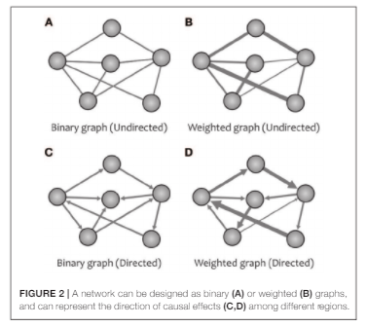
A graph is a mathematical representation of a network. It is usually indicated with G = (V, E), where V is the set of vertices (also referred to as nodes) and E is the set of edges. Any edge consists of a pair of vertices, and can be distinguished according to four different categories:
directed
undirected
binary
weighted edges
An edge is directed when its starting vertex and its ending vertex are specified, otherwise it is said to be undirected.
Whenever it is possible to associate a number to an edge then this number is called the weight of the edge, on the contrary if no weight is associated to an edge then the edge is binary. [1]
[2]

Slide 4
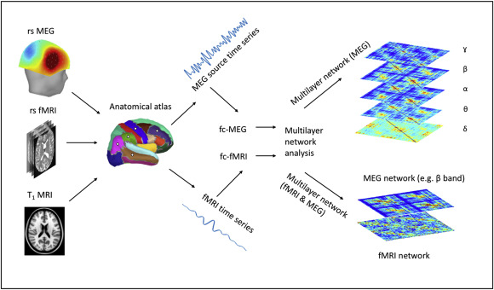
In the last few years, the great development of fields deriving from statistics and the processing of signals deepened in a tangible manner our understanding of how the brain is wired up and connected
There are techniques such as fMRI, EEG, MEG that allow us to understand the connectivity patterns of the brain
This leads up to the formation of NxN multivariate relationships that allow us to have a representation of the brain that can be treated as a graph[2]
[3]

Slide 5
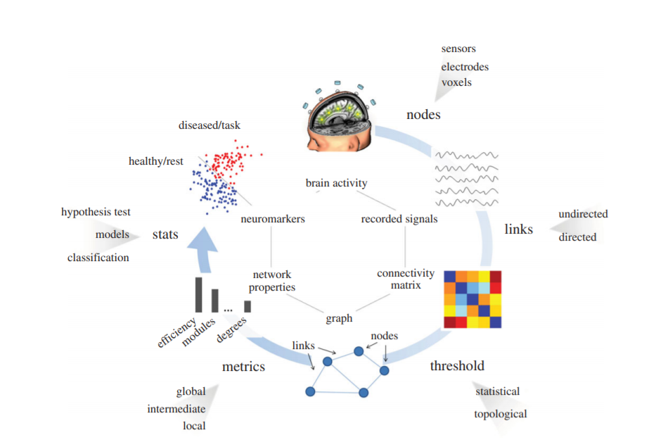
Subsequently from the NxN matrix we derive the graph, study metrics and properties and infer useful information on the brain structure and functioning
[8]

Slide 6
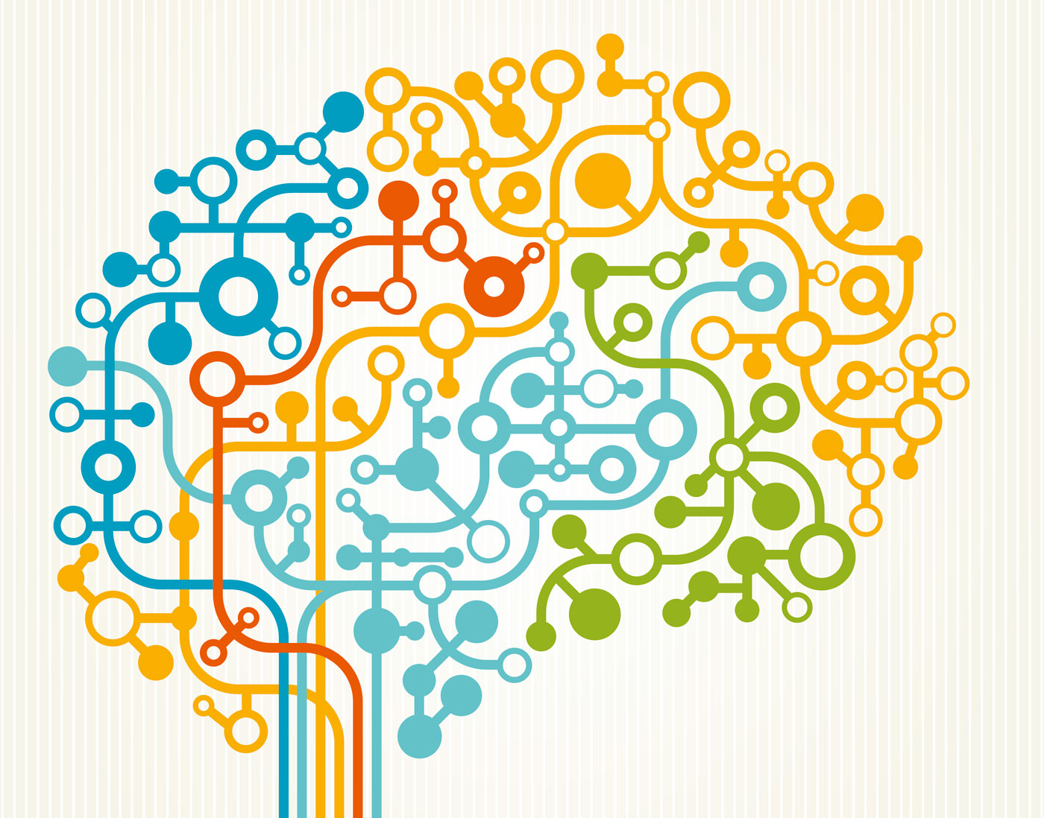
Why Graph Theory is so important in Neuroscience though ?
The answer is that research in this field is centered around questions of how to relate brain functioning to parameters characterizing brain connectivity both in healthy people and in patient affected by neuropathology.
Graph Theory is a perfect candidate in succeeding this challenge, in fact many studies point out that Neurological diseases may be a result of altered connectivity between brain regions.[1]
[4]

Slide 7
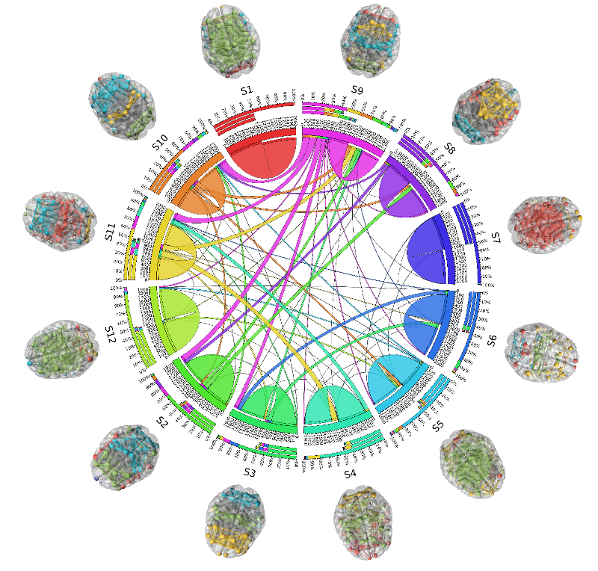
The human connectome describes the complete set of all neural connections of the human brain. It is remarkable how substantively different systems share key characteristics that can be identified by specific parameters such as: connectivity centrality clustering modularity
[1]
[5]

Slide 8
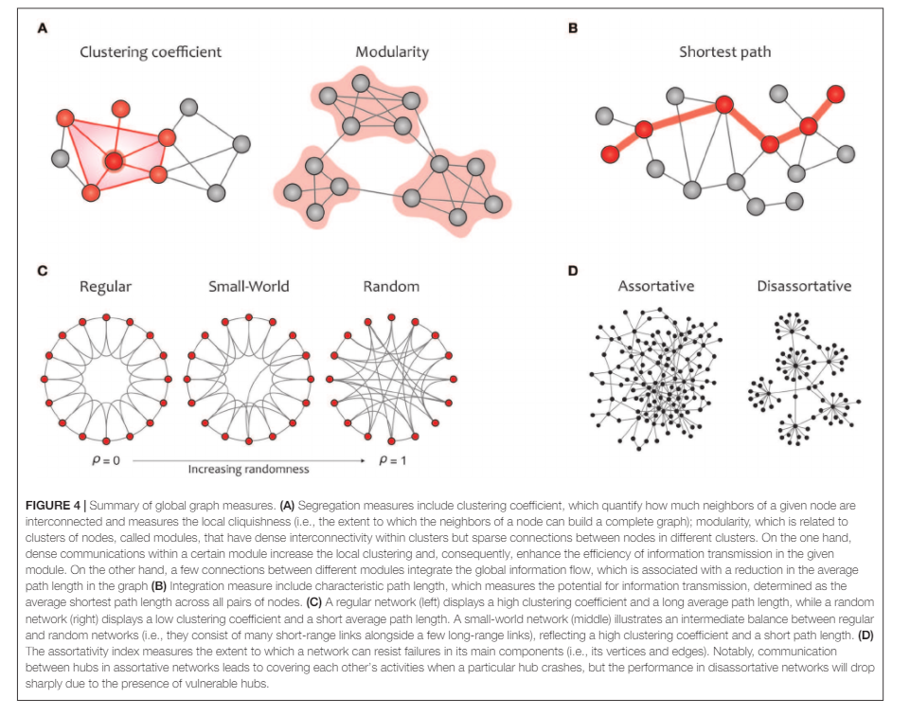
Global Proprieties
Segregation refers to the degree to which network elements form specialized communities, provides insight into the eﬃciency of global information communication.
Clustering coeﬃcients and modularity are the most common metrics that quantify the properties of topological segregation in brain networks
On the other side, functional integration is typically measured by the characteristic path length that quantiﬁes the ability for global information integration.
The small-world property displays an optimal balance between network segregation and integration and is dedicated to graphs in which most nodes are not neighbors but can be reached by any other node with the minimum possible path length .
Eventually, assortativity quantiﬁes network resilience against random or deliberate damages in the main components, which is one of the most signiﬁcant issues in network science
[2]

Slide 9
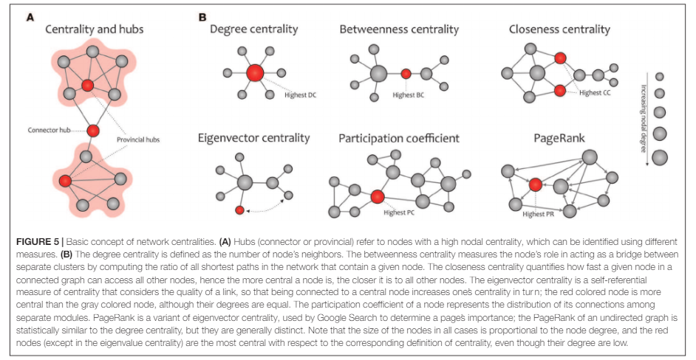
Local Properties
In network science, hubs refer to nodes with a high nodal centrality.
Hub nodes of a network can be the connector or provincial, based on the high or low participation coeﬃcient. Connector hubs tend to interconnect nodes between diﬀerent modules, while the provincial hubs are responsible for linking nodes in the same module
Furthermore, other commonly used indexes for measuring the nodal centrality include betweenness, closeness, and eigenvector, participation coeﬃcient, and PageRank
[2]

Slide 10
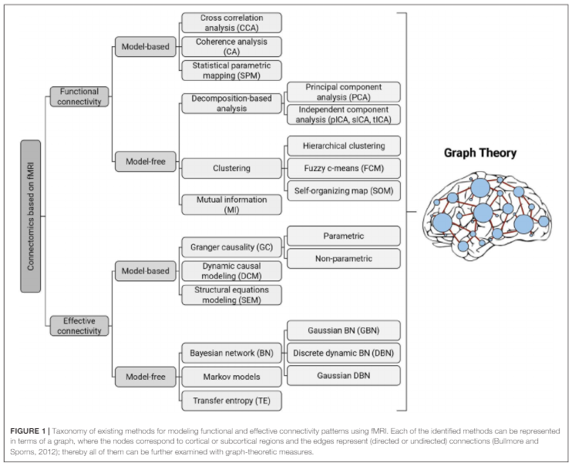
Connectivity patterns
Brain connectivity investigations using fMRI provided a new tool for researchers, especially neuroscientists, to study the human brain network with high precision.
Computational methods available are divided into two general categories:
functional connectivity
effective connectivity
[2]

Slide 11
Connectivities
Functional connectivity
It is defined as the temporal dependency of neuronal activation patterns of anatomically separated brain regions. Basically, functional connectivity refers to statistical dependencies between distinct and (even) distant regions of information processing neuronal populations.
Hence, it is a statistical concept which relies on statistical measures, such as correlation, covariance, spectral coherence, or phase locking.
In this regard it is worthy to recall that statistical dependencies are highly time dependent and fluctuate on multiple time scales ranging form milliseconds to seconds.
Effective connectivity
It is a special kind of functional connectivity.
In detail, effective connectivity describes the influence that one neuronal system or a brain region exerts upon another.
This clearly results in reflecting causal interactions between activated brain areas. In this case direction plays an important role; in fact, direction gives information on which regions influence others. From an experimental point of view statistical causality can be inferred from network perturbations or time series analysis.
Both functional and effective connectivity refer to abstract concepts with no immediate connection to anatomical connectivity which physically mediates such correlations.

Slide 12
Effective Connectivity
“GC core idea is that past data from
one brain region can help estimate the current state in another region”
Model-based
Granger casualty
Dynamic causal modeling
“DCM is based on a general bilinear state equation that quantiﬁes how variations in neural activity in one node are aﬀected by the activation in another node under predeﬁned stimuli”
“BN is a probabilistic model well suited for representing the conditional dependencies over a set of random variables through a directed acyclic graph”
Model-free
Bayesian network
Transfer entropy
“TE is a non-parametric approach measuring the transfer of information between joint processes based on information theory”
[2]

Slide 13
Functional Connectivity
“Cross-correlation analysis is the most traditional method for testing functional connectivity, which is deﬁned by measuring the correlation between the BOLD signals of any two brain regions”
Model-based
Cross-correlation and coherence
Statistical Parameter mapping
“SPM is another model-based approach used to detect region-speciﬁc eﬀects (e.g., brain activation patterns) in neuroimaging data, such as fMRI and PET, using a combination of the general linear model”
“PCA can express the fMRI data with a linear combination
of orthogonal contributors that have the greatest impact on the data variance. Each contributor contains a pattern of time variability multiplied by a pattern of spatial variability”
Model-free
Decomposition based
Clustering
Mutual Information
“The primary goal of clustering algorithms is to group voxels or regions of interest into diﬀerent clusters based on the similarity between their BOLD time courses “
“MI is an information theoretic concept that quantiﬁes the shared information (undirected) between two random variables”
[2]

Slide 14
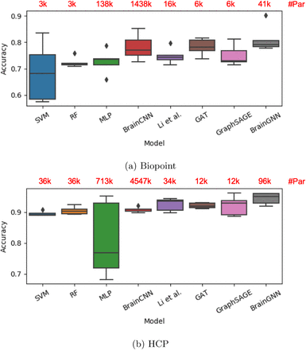
BrainGNN
BrainGNN is an interpretable graph neural network for fMRI analysis. BrainGNN takes graphs built from neuroimages as inputs, and then outputs prediction results together with interpretation results. BrainGNN applied on Biopoint and HCP fMRI datasets not only performs better on prediction than alternative methods, but also detects salient brain regions associated with predictions and discovers brain community patterns. This model seems better than alternative graph learning and machine learning models for classification. This framework is generalizable to other neuroimaging modalities.[1]
Two independent datasets, the Biopoint Autism Study Dataset (Biopoint) [44] and the Human Connectome Project (HCP) 900 Subject Release [42], are used in this work.
[6]

Slide 15
Disorders/Diseases
Disconnection in a brain made up of localized but linked specialized regions results in functional impairment, associating with atypical integration of distributed brain areas. Catani and Ffytche (2005) elaborated the rises and fall of disconnection syndromes and pointed out that many neurological disorders can be explained via these syndromes.
Studies in the ﬁeld of complex brain networks have demonstrated that analyzing the network properties and metrics derived from brain topology can help neurologists distinguish patient groups from control subjects in mental disorders
Many studies that have used graph theory to investigate common neurological disorders and delving deeper into this kind of topics may help us prevent and treat diseases/disorders such as:
Alzheimer’s disease (AD),
Multiple sclerosis (MS),
Autism Spectrum Disorder (ASD),
Attention-deﬁcit/hyperactivity disorder (ADHD),
Parkinson-s disease
Insomnia
Major depression
OCD’s
[2]

Slide 16
Bibliography
[1] Graph Theoretical Analysis of the Brain. An Overview. P. Finotellia,∗ , P. Dulioa
[2] Application of Graph Theory for Identifying Connectivity Patterns in Human Brain Networks: A Systematic Review June 2019 Frontiers in Neuroscience 13:585 DOI: 10.3389/fnins.2019.00585
[3] Comparing multilayer brain networks between groups: Introducing graph metrics and recommendations. Kanad Mandke, Jil Meier, Matthew J. Brookes, Reuben D. O'Dea, Piet Van Mieghem, Cornelis J. Stam, Arjan Hillebrand, Prejaas Tewarie, NeuroImage, Volume 166, 2018, ISSN 1053-8119, https://doi.org/10.1016/j.neuroimage.2017.11.016
[4] Susceptibility mapping of brain blood oxygenation and brain network connectivity, August 21, 2017, ResearchFeatures by Dr Zhifeng Kou
[5] CVIT.iiit.ac.in,Spectral Analysis of Brain Graphs
[6] BrainGNN: Interpretable Brain Graph Neural Network for fMRI Analysis Xiaoxiao Li, Yuan Zhou, Siyuan Gao, Nicha Dvornek, Muhan Zhang, Juntang Zhuang, Shi Gu, Dustin Scheinost, Lawrence Staib, Pamela Ventola, James Duncan bioRxiv 2020.05.16.100057; doi: https://doi.org/10.1101/2020.05.16.100057
[7] Structure of brain networks is not fixed, Georgia State University on Neurosciencenews.com, July 8, 2019
[8] Graph analysis of functional brain networks: practical issues in translational neuroscience. De Vico Fallani F, Richiardi J, Chavez M, Achard S. 2014 Phil. Trans. R. Soc. B 369: 20130521. http://dx.doi.org/10.1098/rstb.2013.0521
[9] Brain network similarity: Methods and applications Ahmad Mheich, Fabrice Wendling and Mahmoud Hassan LTSI, INSERM, U1099, Rennes, F-35000, France

